Slide 1

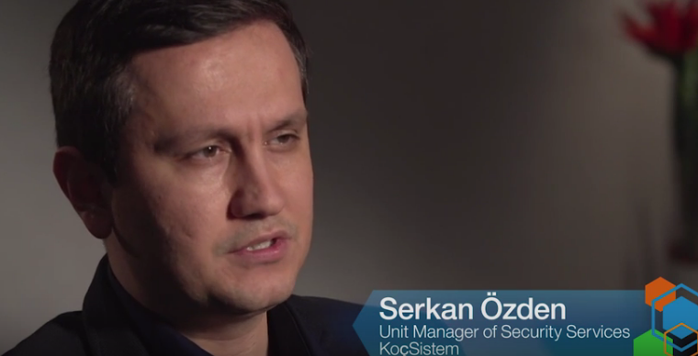




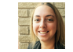

Protect your clients with leadership security technology
IBM Security QRadar meets the security needs of service providers with multi-tenancy capabilities and a master management console. QRadar accelerates your ability to identify and stop cyber threats.
Protect your clients from threats and reduce compliance risk
Watch this video and learn how KoҫSistem, one of the largest IT services companies in Turkey, is complying with regulations using IBM Security QRadar.
Contact IBM
Extend your market reach
.
Have questions?
Speak to Becky, our MSP Specialists to discuss your cloud security needs?
Mention code: C#######
Follow the leader
IBM Security QRadar named a leader in Gartner’s SIEM Magic Quadrant 2015 report.
Join us for a webcast presented by Vijay Dheap, IBM Security Global Solutions Manager, to learn about the new features of IBM Security QRadar designed especially for Managed Service Providers
Get the report
View on-demand recording
Talk to an expert
Notes:
Video KocSistem Replaces Their SIEM & Deploys QRadar For Log Management & Regulatory Compliance https://www.youtube.com/watch?v=XIqBAAMTVrk&index=5&list=PL5VchNLXhuu8EM3-EcUmdN68m6ofEG3vt
Need IWM - Gartner MQ study http://www.gartner.com/technology/reprints.do?id=1-2JM4RVZ&ct=150720&st=sb (Must use this IWM form legal copy - https://www-01.ibm.com/marketing/iwm/dre/signup?source=ibm-WW_Security_Organic&S_PKG=ov37658&dynform=19887
Need IWM - Webcast replay: Extend Your Market Reach with IBM Security QRadar for MSPs Webcast http://www.ibm.com/common/ssi/cgi-bin/ssialias?subtype=ST&infotype=SA&htmlfid=WGV03055USEN&attachment=WGV03055USEN.MP4

